Slide 1

Python Basics for Data Analysis
Larry Gray, PhD
Director of Engineering, KungFu.ai
Faculty at Georgetown University
Core Contributor for Yellowbrick.
LinkedIn: https://linkedin.com/in/larry-gray-phd
Github: github.com/lwgray
Email: lwgray@gmail.com
Dr. Larry Gray
Maryland Institute College of Art
February 2023
About the Instructor

Slide 2
Agenda session 1
Installing Software
Python Overview
What is computing?
Explore the Shell
Interactivate Python

Slide 3
Installing Software
First let’s download and install the Anaconda distribution of Python 3.x for your operating system at
https://www.anaconda.com/distribution
And the text editor Sublime Text from
https://www.sublimetext.com

Slide 4
then A PEP TALK
You can do it!!!

Slide 5

Be Creative & Have Fun!
Notes:
Before we jump right in, I want to acknowledge that this is going to be quite a 0 to 60 mph class as we’re starting with an assumption of basic working familiarity with your computer, and are going to end up learning most of the applied fundamentals you’ll need to know to start working on data software projects. Not to mention in this field, things are always changing rapidly so there is always something new to learn and it can be hard to keep up. Therefore, I recommend if you are ever feeling down about a bug you’re trying to fix or a concept you’re trying to learn, go to hackertyper.net and start mashing your keyboard and it will look like you are a pro software guru in no time!!!

Slide 6
What Is Computing?
Notes:
First let’s establish what computing really is, and start to understand what your computer is made up of. This will help to demystify some of the concepts we talk about later and take the ‘magic’ out of computing.

Slide 7
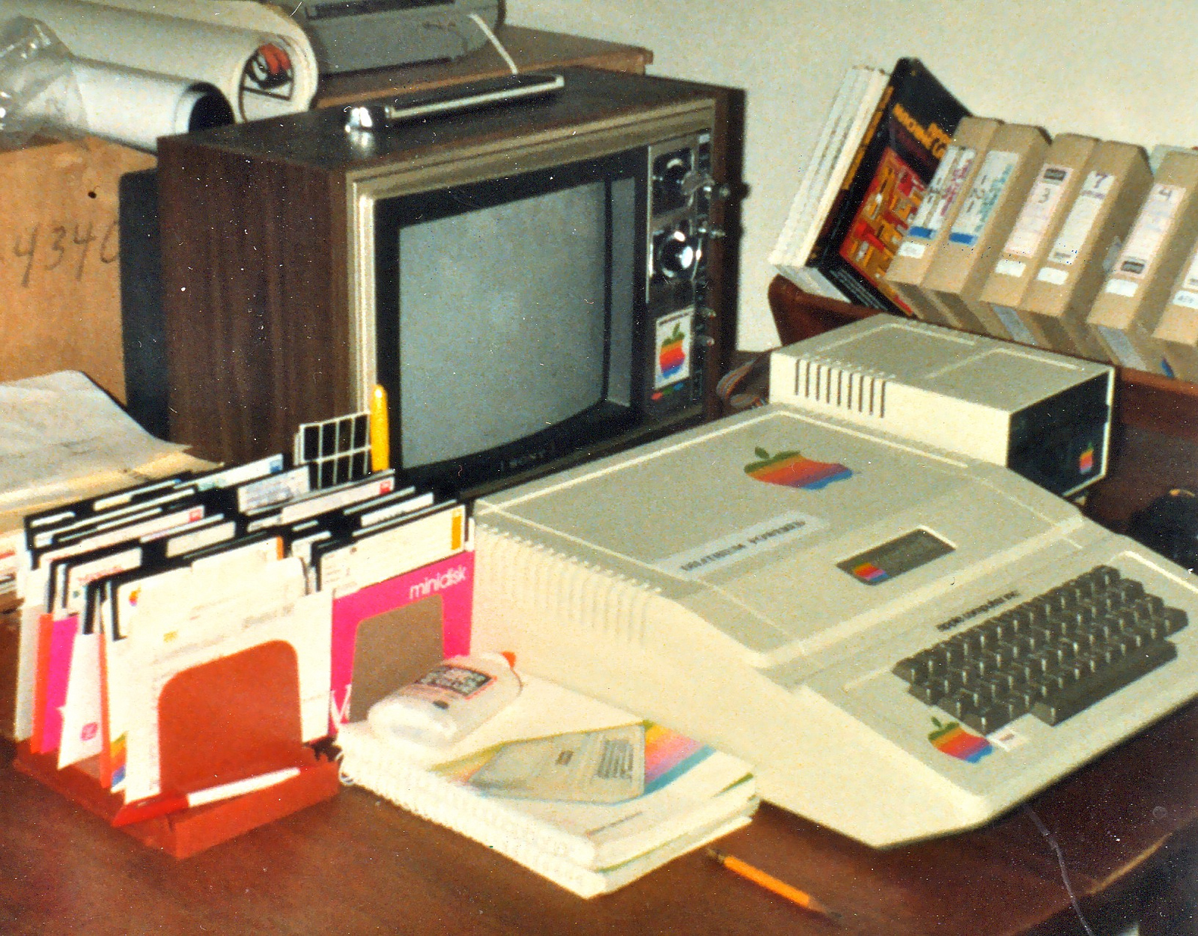
Back to basics
Notes:
Here’s an old-timey computer! Though they look really different now, the underlying concepts are the same. With computation we’re basically just trying to do different types of operations quickly and efficiently on different pieces of data.

Slide 8
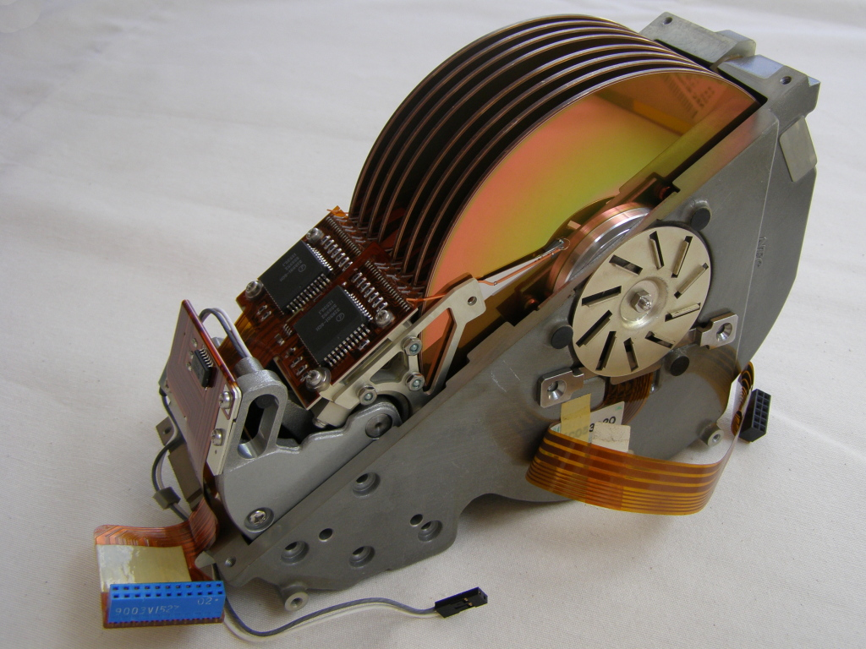
Disk: NEC D5662 Hard disk
Notes:
Here is a hard drive. This is the physical place that your data is stored when you save it to your computer. There are other types of data storage, like USBs or CDs. The simple thing to note here is that when you save data on your computer, it’s just being written somewhere on your storage media so that later operations can access it. When you see people discussing “disk” or “disk I/O”, they’re talking about storing or reading/writing data from this permanent storage location into working memory to be operated on.

Slide 9
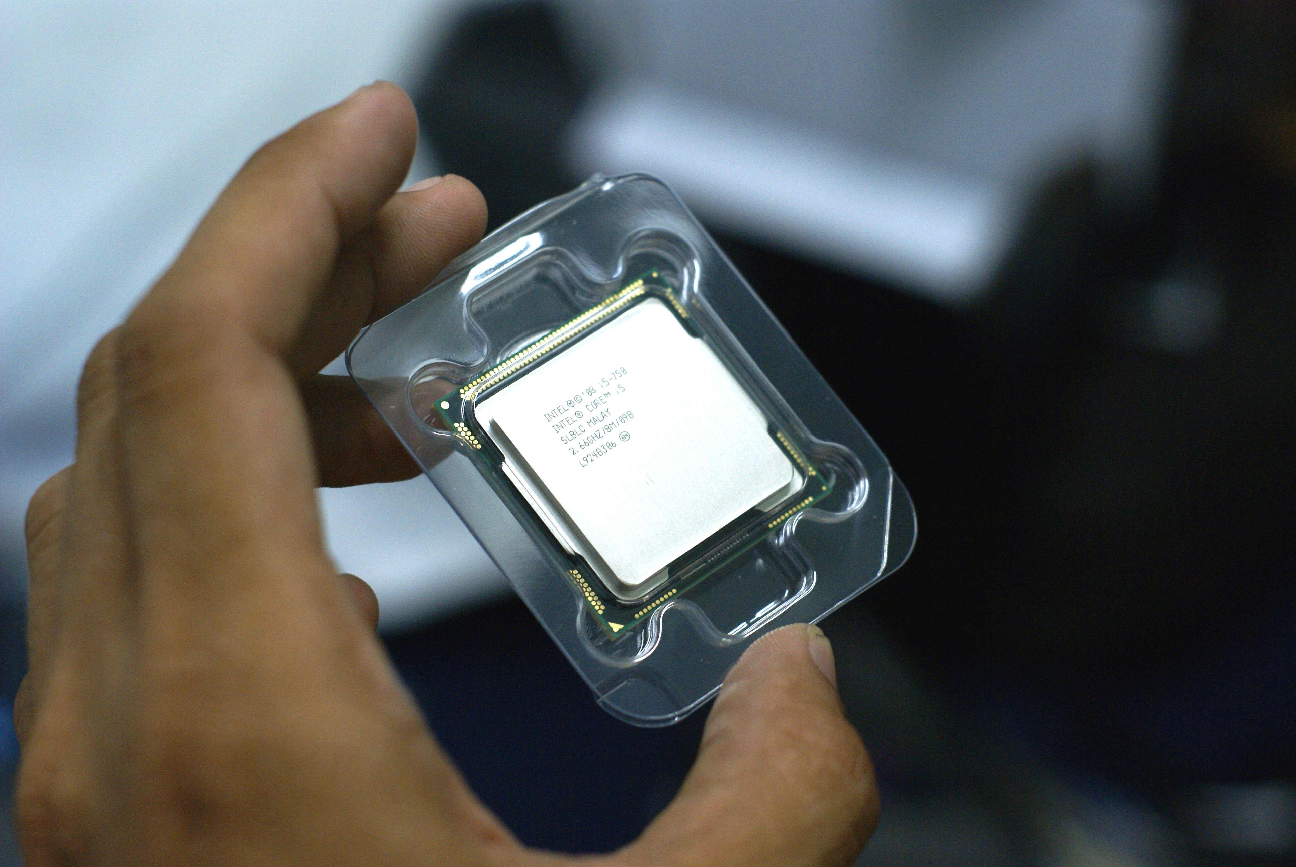
PROCESSOR: Intel Core i5 2.66 GHz
Notes:
Here is a processor. The processor is the physical device that can conduct operations on data it retrieves from the hard disk or other storage device into working memory. When you hear about the term CPU, it’s talking about your processor; when you hear about the term memory or, more precisely, RAM, it’s also talking about the location data is stored while it’s being worked on by the processor.

Slide 10
Computing: So Easy Right?
Disk = Data
Processor = Instructions
Notes:
These two concepts together is really all that your computer knows how to do; store data, and execute operations against it. The hard disk contains the data, and the processor knows how to carry out instructions.

Slide 11
Computing: So Easy Right?
Disk = Data
= Data Types/Classes
Processor = Instructions
= Methods/Functions
Notes:
These ideas map directly to concepts we’ll be talking about when we start talking about writing software. As you write software, you’ll need to access underlying data which is represented as *data types* or *classes*. You’ll also specify operations you can execute against that data, which will be represented by *functions* and *methods*. These terms are going to come up later, and you can always track them back to these basic components of a computer to simplify what is really going on.

Slide 12
Talking To Your Computer
Notes:
Let’s talk about how you normally “talk” to your computer, that is, try to get it to execute instructions on data on your behalf for a specific purpose.

Slide 13
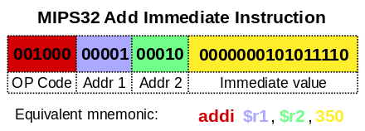
Programming: Instruction Sets/Assembly
Notes:
You may have heard that computer programs are ‘just ones and zeroes”. The simplest, closest-to-computer-language programming language there is are ‘instruction sets’, also called ‘assembly language’. Only very low level programs (low level meaning needing to communicate directly with the hardware of your computer) are written directly with instruction sets or assembly. Most of us don’t want to/need to do this as we are fine interacting with the hardware in some standard way, and over the years ‘higher level’ programming languages have been developed that shortcut some of the things you’d need to encode explicitly with assembly language so it’s easier to write programs that just accept some defaults as to how some of the lower level operations are achieved.

Slide 14
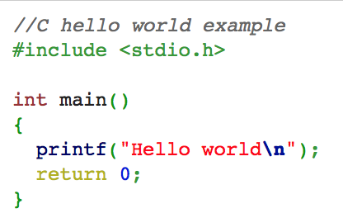
Programming: C
Notes:
One of the earlier and very common ‘higher level’ programming languages is C. C has many derivatives today such as C# or C++, which you also may have heard of. Many programming languages that aren’t exact derivatives of C still borrow many of the concepts or are even written in C underneath. You can see from this example how radically more user friendly C looks compared to assembly language, but C is still relatively low level for our purposes and there are even more languages that have been developed that abstract away more defaults to make programming easier and easier.

Slide 15
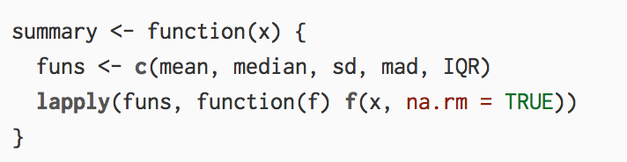
Programming: R
Notes:
Some programming languages are even specialized to a specific type of domain and abstract certain types of operations in such a way that benefit that domain specifically. One programming language some of you might have heard of, that is very commonly used for data analysis, is R. It was specifically developed to aid in data analysis and statistical programming, so some of the things you might have to write custom code to do in other languages, such as read a CSV file, is already included in R out of the box. You can see that this also looks a lot easier to read and understand than assembly language, and is also a little more friendly looking than C. R is primarily developed and used in the academic world and/or by statisticians. It’s often taught for data analysis purposes, but for reasons I’m about to get into, we’ll be learning a different language instead.

Slide 16
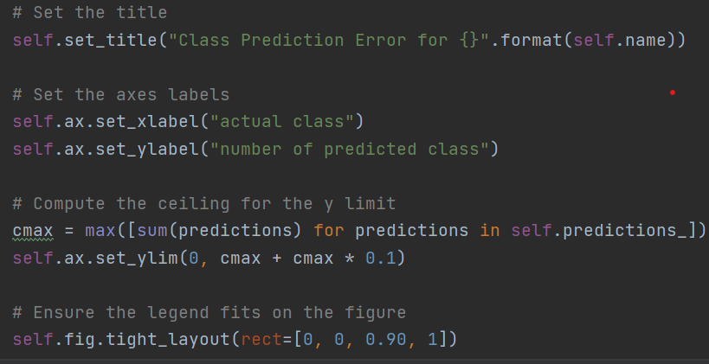
Programming: Python
Notes:
The programming language we’ll be learning for this class is Python. Python is well liked especially as a first language because it is so easy to read, with limited “computery” syntax like brackets or semicolons. However, it’s also well liked because it has powerful data analysis capabilities, some derived directly from concepts in R, while also being good for a number of other purposes such as web development, system administration, or simple scripting.

